Slide 1

For Beginners!
© Copyright Matthew Flood, 2022

Slide 2
For Beginners!
Week 5:
Relationship to MatLab & NumPy
Important Packages
Stats 101
Vector/Matrix Operations

Slide 3
Relationship to MatLab & NumPy
Julia is first and foremost a mathematical programming language.
The founding developers of Julia are mathematicians, so advanced mathematics functions are its core strengths.
Other mathematical programming languages, like MatLab, are good for matrix-based operations. However, MatLab is slow in many other respects, such as for loops, and don’t have the same dynamism of newer languages.
Packages in dynamic, object-oriented programming languages emulate the functionality of MatLab, like NumPy in Python, but lack the ease-of-use in terms of manipulating large data arrays
R is good for stats…
Or so people tell me….

Slide 4
What is a Set?
A Set in Julia is a collection of elements just like arrays, dictionaries, etc.
Sets are different from arrays because sets are unordered and only contain unique elements, i.e. no duplicates
Sets are mutable data types, which means its values can be altered, deleted, overwritten, etc.
Sets can contain elements of any data type.
MySet = Set([Value1, Value2, …, ValueN])

Slide 5
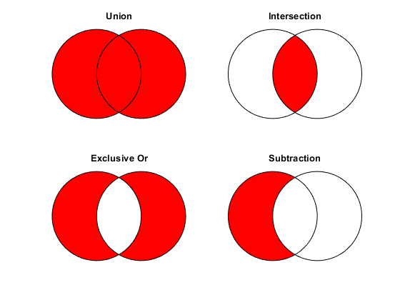
Why use sets?
The great advantage of sets are that they allow you to set-based operations like you would in general mathematics
Examples:
union(SetA, SetB)
intersect(SetA, SetB, SetC)
setdiff(SetA, SetB)
Also…
⊊, ⊈, ∩, ∪, contains()

Slide 6
Useful common functions
abs()
floor()
ceil()
round()
sqrt()
rand()
sum()
prod()
log()
exp()
mod()
using LinearAlgebra
tr()
det()
inv()
diag()
eigenvals()
eigenvecs()
UpperTriangular()
LowerTriangular()
dot()
cross()
diagonal()
I()
using Statistics
mean()
median()
std()
var()
cor()
cov()
middle()
quantile()
using StatsBase
skewness()
kurtosis()
moment()
sem()
mad()
span()
iqr()
mode()
counts()
proportions()
Histogram()
fit()
ecdf()
cbrt()
factorial()
lcm()
gcd()
imag()
conj()
cat()
vcat()
hcat()
any()
all()
length()
size()
zeros()
ones()

Slide 7
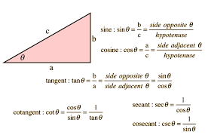
Trigonometry
sin() or sind()
cos() or cosd()
tan() or tand()
asin() or asind()
acos() or acosd()
atan() or atand()
sec() or secd()
csc() or cscd()
cot() or cotd()
asec() or asecd()
acsc() or acscd()
acot() or acotd()
hypot()
sinh() asinh()
cosh() acosh()
tanh() atanh()
sech() asech()
csch() acsch()
coth() acoth()

Slide 8
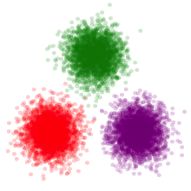
Useful Maths Packages ☺
LinearAlgebra.jl
FFTW.jl
DifferentialEquations.jl
MLBase.jl
Clustering.jl
StatsPlots.jl
ScikitLearn.jl
Interpolations.jl
Statistics.jl
StatsBase.jl
StatsModels.jl
Distributions.jl
GLM.jl
MixedModels.jl
HypothesisTests.jl
TimeSeries.jl
StatsFuns.jl
MultivariateStats.jl

Slide 9
Importing Data
DelimitedFiles.jl
DelimitedFiles.jl is a package that provides methods for importing data from files with data columns separated by a delimiter, e.g. tab, comma, space, etc.
When you have data saved in text files (.txt), you will use DelimitedFiles.jl
using DelimitedFiles
Data = readdlm(source, delim::AbstractChar,
T::Type, eol::AbstractChar;
header=false, skipstart=0,
skipblanks=true, use_mmap,
quotes=true, dims, comments=false, comment_char='#')

Slide 10
Importing Data
DelimitedFiles.jl
Example:
Say you have a file called “Subject001.txt” where data is separated by tabs. We want to import the data as a matrix, ignore the header at the top of the file and skip the first 3 rows.
Data = readdlm(raw“C:/MyPC/…/Subject001.txt”, ‘\t’,
header=false,
skipstart=3)
File location path. Note the use of ‘raw’ before the string to account for non-ascii chars!
‘\t’ is the special char for tabs
Ignore the header and skip the first 3 rows

Slide 11

Dot Operator . . .
Most basic functions in Julia accept only scalar arguments.
So what happens when we want to apply a function to a whole collection of data (tuple, array set, etc.)?
Applying the function to each element in the collection is not feasible
To overcome this issue,
we use the dot operator

Slide 12
Dot Operator . . .
julia> x = round(3.142) # simple rounding of scalar value
3
julia> Data = rand(4)*100
[2.555, 15.582, 99.012, 63.928]
julia> x = round.(Data) # rounding of each value in tuple
[3, 16, 99, 64]
julia> y = sind(47.2) # simple sin (deg) of scalar value
0.73373
julia> Data = rand(4)*100
[2.555, 15.582, 99.012, 63.928]
julia> x = sind.(Data) # sin (deg) of each value in tuple
[0.044, 0.268, 0.987, 0.898]

Slide 13
Dot Operator . . .
When you want to do multiple operations in a single command, make sure you use the dot operator for each function!!!
Example:
julia> x = [3.4, 5.7, 1.1, -7.3, -0.2]
julia> y = log.(abs.(x.^3))
[3.671 5.221 0.285 5.963 -4.828]
julia> z = mean(y)
2.063

Slide 14
For Beginners!
Homework Week 4:
Complete exercise sheet for Week 5

Slide 15
Like learning a real language, the only way to become fluent is to practice.
OK, let’s start writing some code!!!

Slide 16
Importing Data
CSV.jl
CSV.jl is a package that provides methods for importing data from comma separated files (CSV).
When you have data saved in csv files (.csv), you will use CSV.jl
using CSV
Data = read(source,
header=1,
skipto=0,
transpose=false,
ignoreemptyrows=true
footerskip::Int)

